Slide 1
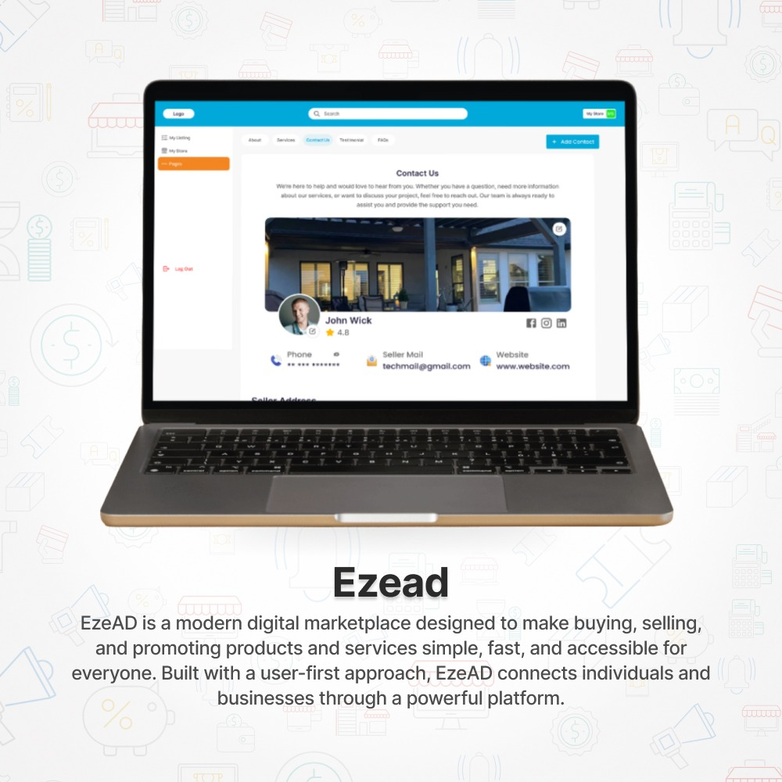
EzeAD
A Fully Built Global Marketplace Platform Ready to Scale
4 Years Built | Live Platform | Ready for Commercial Activation
Investor Deck
AI-Enabled Digital Commerce Infrastructure
A fully built, multi-category marketplace ecosystem integrating classifieds, auctions, services, jobs, business promotion, and scalable digital commerce tools into one unified platform.
Stage: Built, Operational, Launch-Ready, Commercialization Phase
Prepared For: Strategic Investors, Private Backers, Growth Capital Partners

Slide 2
1. Investment Thesis
De-risked, fully built platform — 4+ years of development with a live marketplace and mobile apps already operational
Category-defining ecosystem — classifieds, services, jobs, auctions, and business tools integrated into one scalable platform
AI-powered growth engine — optimizing listing quality, visibility, and conversion performance at scale
Solving a proven broken market — addressing global failures in trust, user experience, and fragmented commerce systems
Multiple monetization layers ready — subscriptions, featured visibility, lead generation, and transaction-based revenue
Scalable acquisition model — freemium entry enabling rapid user growth and strong network effects
The opportunity is not to build EzeAD. The opportunity is to activate, commercialize, and scale it.

Slide 3
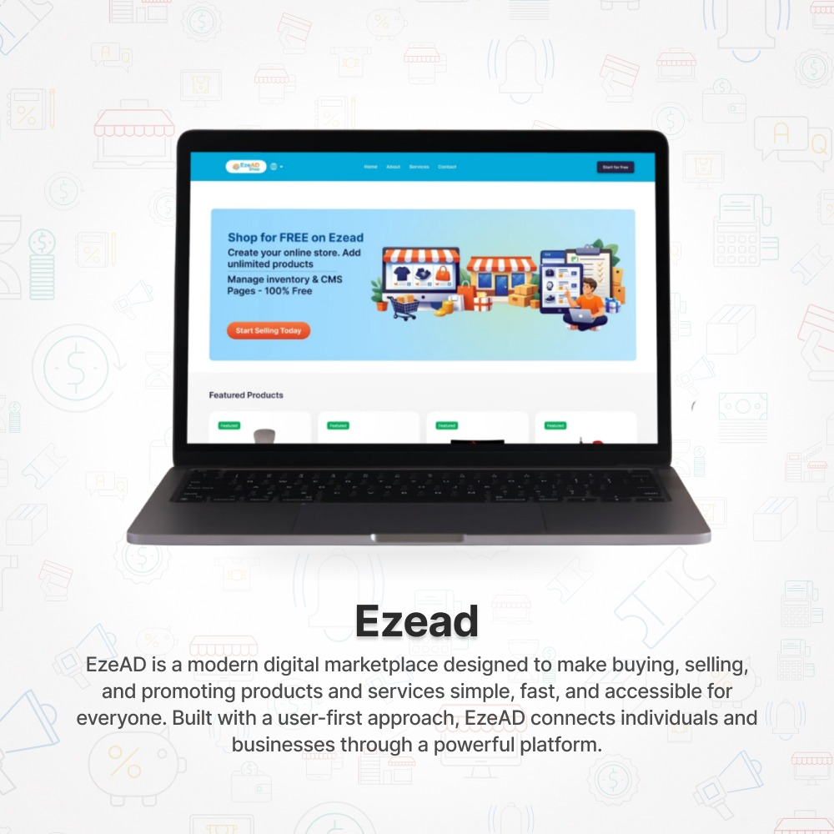
2. What EzeAD Is
A unified, AI-powered marketplace infrastructure replacing multiple fragmented platforms with one scalable ecosystem
Platform Breakdown
Listings — buy & sell products locally and globally
Auctions — dynamic price discovery and competitive selling
Services — connect service providers with demand
Jobs — hiring and opportunity marketplace
Business Pages — digital presence and promotion for businesses
The Core Advantage
✅ All-in-one platform — replacing 5+ separate platforms with a single integrated system
Supporting Links
Main Platform: https://www.ezead.com
Investor Page: https://www.ezead.com/pages/ezead-Investors Mission Page: https://www.ezead.com/pages/our-mission-at-ezead

Slide 4
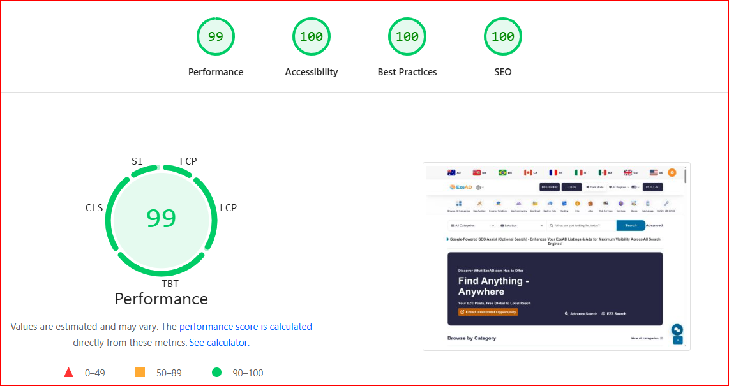
3. Infrastructure Performance Advantage
Why It Matters
Near-perfect platform efficiency — EzeAD achieves a 399/400 performance score, placing it at the top tier of global platforms
Outperforms industry leaders — exceeding platforms like eBay, Shopify, and Facebook Marketplace by 20–40% in performance efficiency
Built for speed and scalability — lightweight, optimized infrastructure designed for high-volume traffic and global expansion
Superior user experience — faster load times directly improve engagement, conversion rates, and retention
Lower operational overhead — efficient architecture reduces server load, cost, and long-term scaling complexity
🏆 EzeAD vs Global Platforms (PageSpeed Score / 400)
EzeAD — 399
⬛⬛⬛⬛⬛⬛⬛⬛⬛⬛ (Near Perfect)
Craigslist — 350–380
⬛⬛⬛⬛⬛⬛⬛⬛⬜⬜ (Fast but outdated)
Shopify — 300–340
⬛⬛⬛⬛⬛⬛⬛⬜⬜⬜ (Optimized commerce)
Kijiji — 260–300
⬛⬛⬛⬛⬛⬛⬜⬜⬜⬜ (Ad-heavy system)
eBay — 250–310
⬛⬛⬛⬛⬛⬛⬜⬜⬜⬜ (Complex infrastructure)
Facebook Marketplace — 200–280
⬛⬛⬛⬛⬛⬜⬜⬜⬜⬜ (Heavy social system)
Performance Benchmark
EzeAD Score: ~399 / 400
Source: Google PageSpeed Insights
https://pagespeed.web.dev/analysis/https-www-ezead-com/odyk7pjmnu?form_factor=desktop

Slide 5
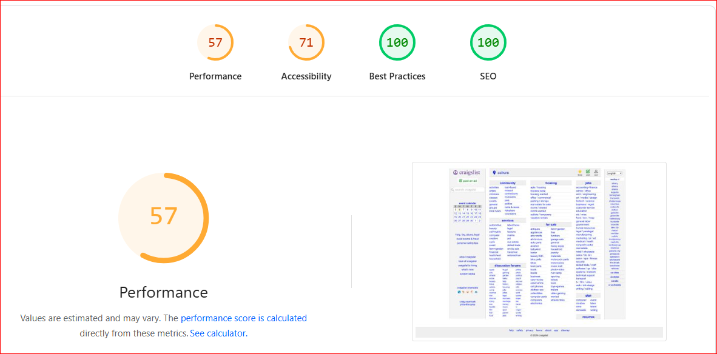
4. PageSpeed Benchmark Comparison
Desktop Performance — Total Score EzeAD (399/400)
Benchmark Overview
1- EzeAD: ~399 / 400 🏆 (Industry-leading)
► Google PageSpeed Insights (EzeAD)
► https://pagespeed.web.dev/analysis/https-www-ezead-com/odyk7pjmnu?form_factor=desktop
2- Craigslist: ~328/400 (High, but minimal system)
► Google PageSpeed Insights (Cragslist)
► https://pagespeed.web.dev/analysis/https-auburn-craigslist-org/5yw5nnc9bq?form_factor=desktop

Slide 6
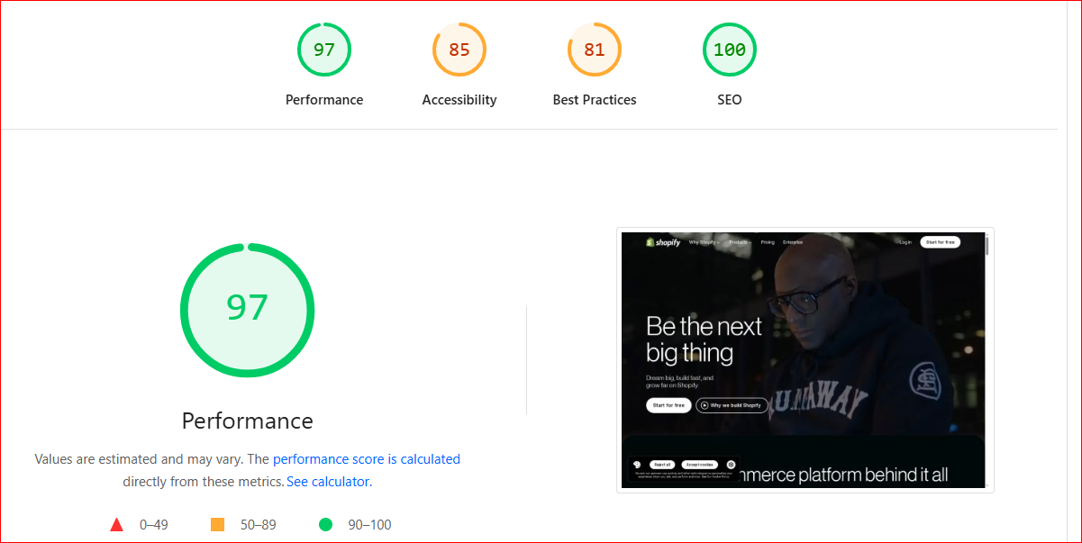
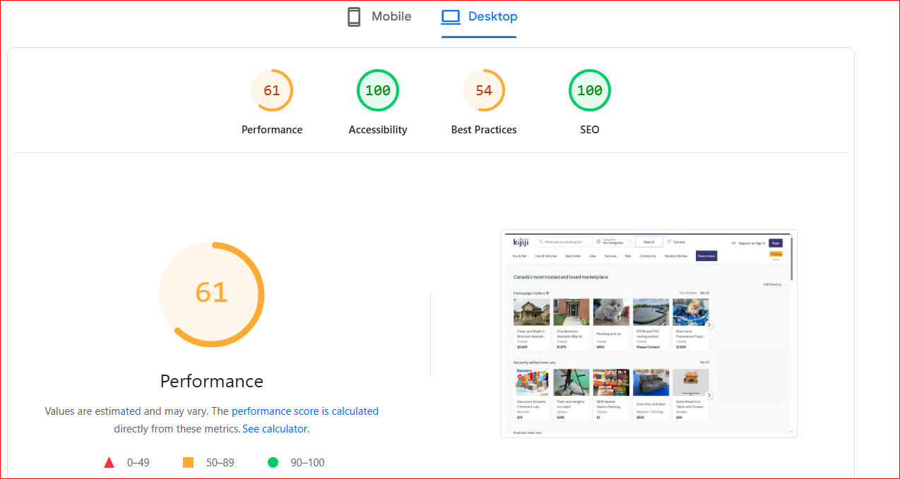
5. PageSpeed Benchmark Comparison
Desktop Performance — Total Score EzeAD (399/400)
3. Shopify: ~363/400 (Optimized commerce)
► Google PageSpeed Insights (Shopify)
► https://pagespeed.web.dev/analysis/http-shopify-com/2s5iw6pkao?form_factor=desktop
4. Kijiji: ~315-400 (Ad-heavy system)
►Google PageSpeed Insights (Kijiji)
► https://pagespeed.web.dev/analysis/https-kijiji-ca/jniv8afzbu?form_factor=desktop

Slide 7
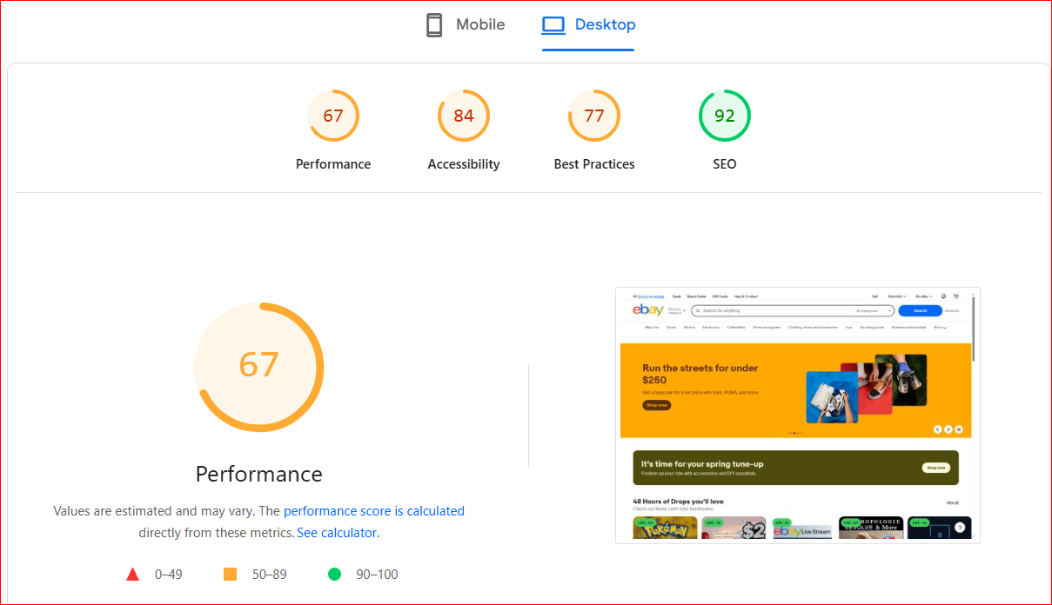
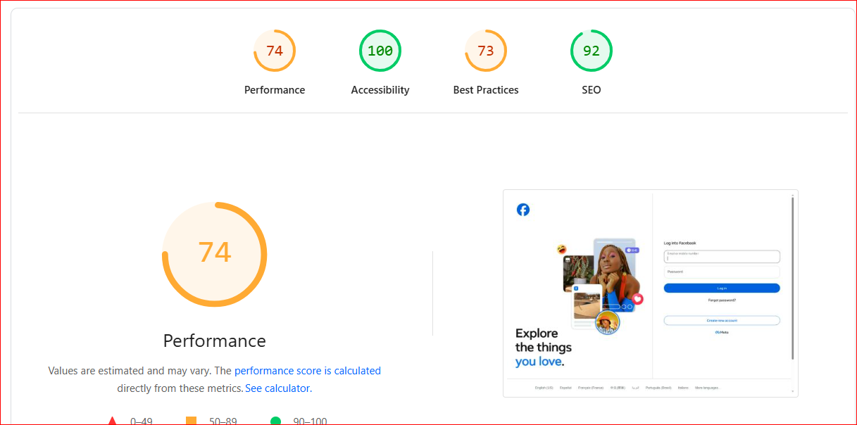
6. PageSpeed Benchmark Comparison
Desktop Performance — Total Score EzeAD (399/400)
5. eBay: ~320-400 (Complex infrastructure)
► Google PageSpeed Insights (eBay)
► https://pagespeed.web.dev/analysis/https-ebay-com/0h13crugte?form_factor=desktop
6. Facebook Marketplace: ~339/400* (Heavy social system)
► Google PageSpeed Insights (Facebook)
► https://pagespeed.web.dev/analysis/https-facebook-com/nn3vii9lbt?form_factor=desktop

Slide 8
7. PageSpeed Benchmark Comparison
Desktop Performance — Total Score EzeAD (399/400)
Simple Benchmark Table
Platform | Score (/400) | Position
EzeAD | ~399 | 🏆 Industry-leading
Craigslist | ~350–380 | High (but minimal system)
Shopify | ~300–340 | Strong
Kijiji | ~260–300 | Moderate
eBay | ~250–310 | Moderate
Facebook Marketplace | ~200–280* | Heavy system
EzeAD achieves near-perfect PageSpeed performance 🏆(~399/400), while global competitors operate 20–40% less efficiently at the infrastructure level
1- EzeAD: ~399 / 400 🏆 (Industry-leading)
Google PageSpeed Insights (EzeAD)
► https://pagespeed.web.dev/analysis/https-www-ezead-com/odyk7pjmnu?form_factor=desktop

Slide 9
8. The Vision
To become the operating system for global digital commerce
What We’re Building
A unified marketplace infrastructure replacing fragmented platforms
A system where users can buy, sell, promote, hire, and transact — all in one place
A scalable foundation for local and global commerce across multiple categories
The Future We See
Millions of users operating within a single, integrated ecosystem
Businesses, individuals, and service providers connected through one platform
Commerce powered by AI, trust, and performance — not fragmentation
Strategic Direction
Move beyond listings → into full commerce infrastructure
Expand from marketplace → into transaction, payments, and business tools
Scale from local adoption → to global platform dominance
EzeAD is not building another marketplace — it is building the infrastructure layer for how digital commerce operates.

Slide 10
9. The Market Problem
Global marketplaces are proven — but fundamentally broken
Fragmented User Experience
Users must switch between multiple platforms to complete basic commerce needs
No single system supports buying, selling, services, jobs, and promotion together
👉 Result: friction, inefficiency, and lost opportunities
Trust & Safety Breakdown
Facebook Marketplace: high scam exposure, weak verification
Craigslist: minimal moderation, outdated safeguards
Kijiji: inconsistent trust systems, unreliable listings
eBay: complex dispute processes, declining user trust
👉 Result: users operate with high risk and low confidence
Poor User Experience & Platform Complexity
eBay / Shopify: complex workflows, multi-step processes
Facebook Marketplace: unstructured and inconsistent
Craigslist: outdated interface and poor usability
👉 Result: reduced engagement, lower conversion rates
Monetization Misalignment
Increasing fees, ads, and pay-to-play visibility
Organic reach declining across all major platforms
👉 Result: platforms profit, but users lose value
No Unified Commerce Infrastructure
Platforms operate as isolated tools, not integrated ecosystems
Users forced to rely on multiple services to complete one transaction journey
👉 Result: fragmentation limits scalability and user retention
Multi-billion-dollar platforms have validated the market — but failed to solve its core problems.

Slide 11
10. The EzeAD Solution
A unified, AI-powered marketplace infrastructure designed to fix what global platforms failed to solve
All-in-One Commerce Ecosystem
Listings, services, jobs, auctions, and business promotion in one integrated platform
Eliminates fragmentation across multiple disconnected marketplaces
Enables complete commerce journeys within a single ecosystem
Trust-First Infrastructure
Built-in verification, moderation, and transparent interactions
Designed to reduce fraud, scams, and low-quality listings
Creates a safer, more reliable marketplace environment
AI-Powered Performance Layer
Enhances listing quality, visibility, and conversion rates
Optimizes seller performance and buyer discovery
Drives better outcomes for both users and businesses
Seamless User Experience
Clean, modern, mobile-first design
Simplified workflows across all marketplace activities
Faster, more efficient interactions → higher engagement and retention
Aligned Monetization Model
Free entry → frictionless growth
Monetization through value-driven upgrades (not forced paywalls)
Focused on user success, not platform extraction
Scalable Infrastructure
High-performance architecture built for global scale
Lower operational cost with efficient system design
Ready to support millions of users and transactions
👉 EzeAD is not another marketplace — it is the infrastructure layer that eliminates the need for fragmented platforms.
Where legacy platforms are fragmented, complex, and misaligned — EzeAD is unified, efficient, and built for scale.

Slide 12
11. Built Infrastructure = Lower Risk
EzeAD is not a concept, It is a fully developed, operational platform ready to scale
Execution Already Completed
4+ years of development invested into building a complete marketplace ecosystem
Fully functional web platform + mobile applications (iOS & Android)
Core systems — AI tools, messaging, moderation, and marketplace engine — already live
Reduced Investment Risk
No dependency on future product development or technical uncertainty
Capital is deployed toward growth, monetization, and market expansion — not building from scratch
Eliminates typical early-stage risks of product failure or delayed execution
Faster Path to Revenue
Monetization systems already structured and ready for activation
Ability to convert existing platform activity into revenue quickly
Shorter timeline from investment → commercial returns
Proven Product Foundation
Platform tested, refined, and iterated over multiple years
Built with scalability, performance, and real-world usage in mind
Positioned at the commercialization stage, not experimentation
The risk is no longer building the product — the opportunity is scaling what already exists.
Supporting Links
Marketplace / Shop: https://www.ezead.com/shop Blog / SEO Engine: https://www.ezead.com/blog

Slide 13
12. Why This Is Investable
A rare opportunity to invest in a fully built platform at the point of scale
De-Risked Investment Opportunity
Product already built and operational — eliminates early-stage execution risk
Proven infrastructure across web, mobile, AI, and marketplace systems
Investment focuses on scaling, not building
Multiple Revenue Streams Ready
Subscriptions, featured listings, business accounts, and lead generation
Designed for recurring and scalable revenue growth
Clear path from user activity → monetization → profitability
Strong Market Opportunity
Multi-billion-dollar global marketplace industry already validated
Existing platforms show high demand but clear structural weaknesses
EzeAD positioned to capture users underserved by current systems
Scalable Business Model
Freemium acquisition → network effects → monetization layers
Growth driven by user adoption, marketplace density, and repeat usage
Built for regional expansion and global scalability
Capital Efficiency
4+ years of development already completed
Lower cost of scaling due to optimized infrastructure
Investment accelerates growth and revenue, not product creation
Positioned for Category Leadership
Not a niche platform — a multi-category commerce ecosystem
Designed as infrastructure, not a single-use marketplace
Potential to become a dominant, category-defining platform
This is not a speculative startup; it is a scale-ready platform positioned to convert infrastructure into revenue and market share.

Slide 14
13. EzeAD SEO Proof
SEO as a Competitive Moat
Search-first marketplace architecture
Every listing becomes an indexed asset
Compounding organic traffic engine
Lower CAC vs paid-dependent competitors
SEO Infrastructure Advantage
Geo-structured pages (country → city → category → listing)
Scalable indexing across all verticals
AI-optimized content and listings
Search-driven user acquisition

Slide 15
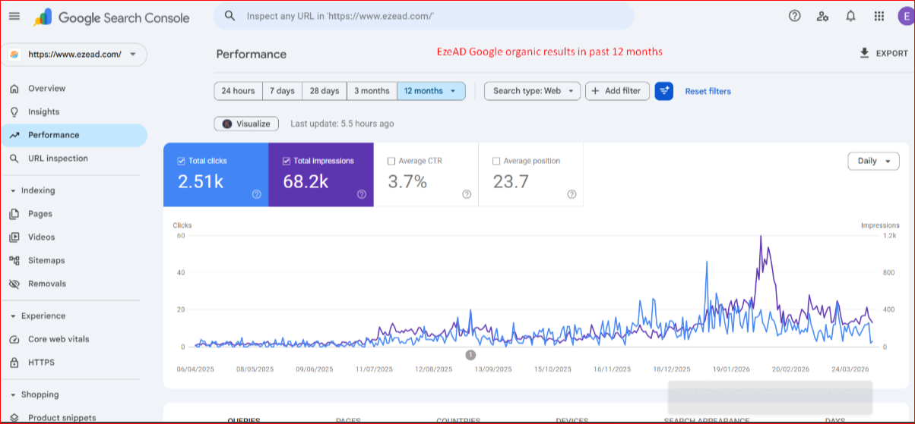
14. EzeAD SEO Proof
A. Technical SEO Proof​
~399/400 Google PageSpeed (near perfect)​
Fast load speeds → higher rankings​
Mobile-first optimization​
High crawlability and indexing efficiency
Proof URL: https://pagespeed.web.dev/analysis/https-www-ezead-com/odyk7pjmnu?form_factor=desktop
B- Google Search Console (Proof)

Slide 16
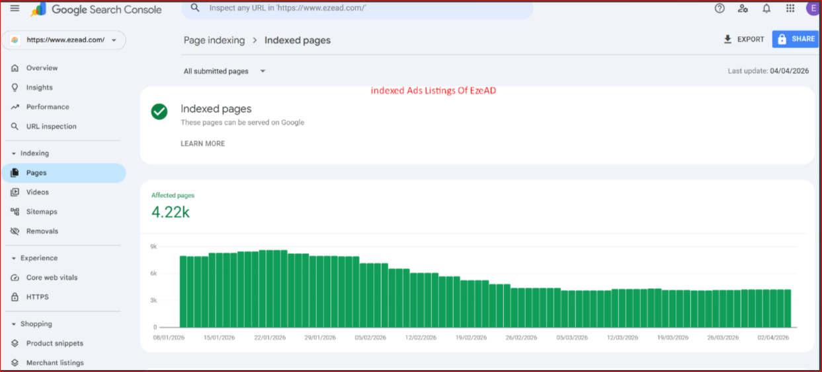
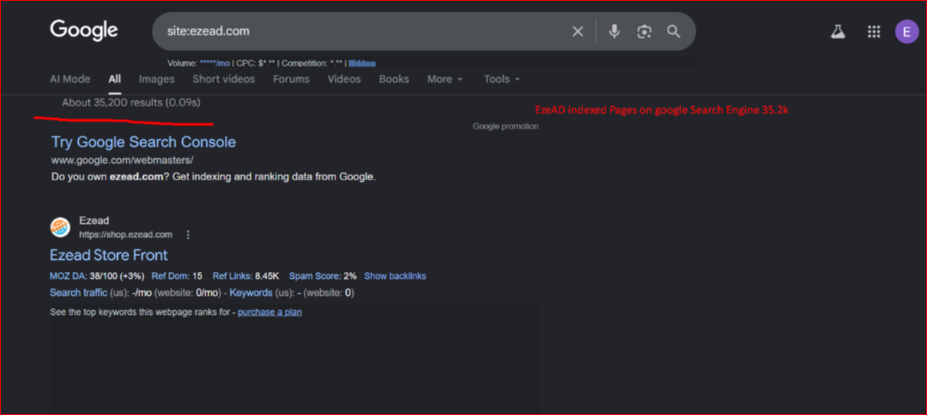
C- Google Search Rankings (Proof)
- site:ezead.com results
- Keyword rankings

Slide 17
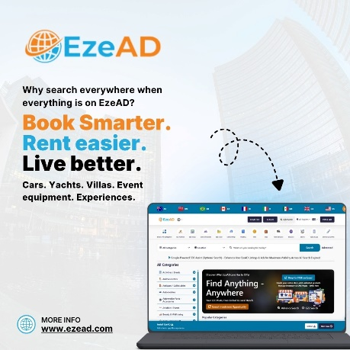
16. Product Ecosystem
A multi-layered marketplace ecosystem designed to drive engagement, retention, and monetization at scale
Core Marketplace Layers
Classified Listings — buy and sell products locally and globally
Auctions — dynamic selling with competitive price discovery
Services Marketplace — connect service providers with real demand
Jobs & Opportunities — hiring and income generation within the platform
Business Promotion — digital presence and growth tools for businesses
Growth & Engagement Layer
Messaging System — real-time buyer-seller communication
User Interaction Tools — enabling direct engagement and faster conversions
Mobile Apps (iOS & Android) — seamless access across devices
AI & Performance Layer
AI-assisted listing optimization — improves quality and visibility
Search & discovery enhancements — better matching of buyers and sellers
Performance-driven exposure — rewarding high-quality listings
Monetization Layer
Featured listings and visibility upgrades
Business accounts and subscription plans
Lead generation and performance-based promotion
Future expansion into transaction and payment systems
Ecosystem Advantage
Each layer strengthens network effects, retention, and monetization potential
Users can complete entire commerce journeys within one platform
Designed as infrastructure, not a single feature product
EzeAD is not one product — it is an interconnected ecosystem where every layer drives growth, engagement, and revenue.

Slide 18
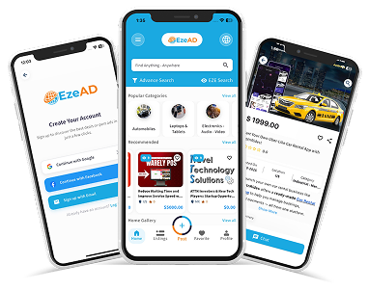
17. Technology & AI Layer
A high-performance, AI-powered foundation designed to optimize, scale, and continuously improve marketplace outcomes
AI-Driven Marketplace Optimization
AI enhances listing quality, structure, and visibility
Improves search relevance and buyer-seller matching
Drives higher conversion rates and transaction efficiency
Performance & Infrastructure Excellence
Near-perfect performance (~399 / 400 PageSpeed)
Lightweight, optimized architecture for speed and scalability
Designed to handle high traffic with consistent performance
Smart Discovery & Ranking Engine
Intelligent algorithms prioritize high-quality, relevant listings
Performance-based exposure — rewarding user success, not ad spend
Continuous optimization of user engagement and marketplace activity
Integrated Communication Layer
Built-in real-time messaging system
Reduces friction between buyers and sellers
Keeps all interactions within the platform ecosystem
Scalable, Modular Architecture
Flexible system design enabling rapid feature expansion
Supports integration of future layers: payments, transactions, business tools
Built to evolve into a full commerce infrastructure platform
Data-Driven Growth Engine
Platform continuously learns from user behavior and interactions
Enables smarter recommendations, targeting, and monetization strategies
Improves efficiency across acquisition, engagement, and revenue
EzeAD’s technology is not just functional — it is an intelligent, performance-driven system built to scale, optimize, and lead the next generation of digital commerce.

Slide 19
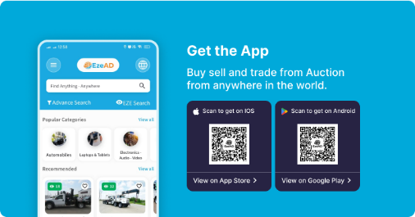
18. Market Opportunity
A massive, proven global market — ready for a better infrastructure
Large & Expanding Market
Global marketplace and digital commerce industry is a multi-trillion-dollar opportunity
Billions of users actively participate in buying, selling, services, and local commerce
Rapid growth driven by mobile adoption and digital-first behavior
Validated Demand — Broken Execution
Platforms like Facebook Marketplace, eBay, Craigslist, Shopify, and Kijiji have proven demand
However, they suffer from trust issues, fragmentation, poor UX, and monetization misalignment
👉 Demand is not the problem — infrastructure is
Massive Underserved Segment
Individuals, small businesses, and service providers lack affordable, efficient digital exposure
Existing platforms prioritize ads and fees over user success
Growing need for low-cost, high-performance alternatives
Shift in User Behavior
Users moving toward simpler, faster, and more integrated platforms
Increasing preference for all-in-one ecosystems over fragmented tools
Trust, performance, and efficiency becoming key decision drivers
EzeAD’s Opportunity Position
Positioned at the intersection of market demand + platform failure
Built to capture users from multiple categories within one system
Ability to scale from local markets → global commerce infrastructure
The market is already massive and proven — the opportunity is to rebuild it with the right infrastructure.

Slide 20
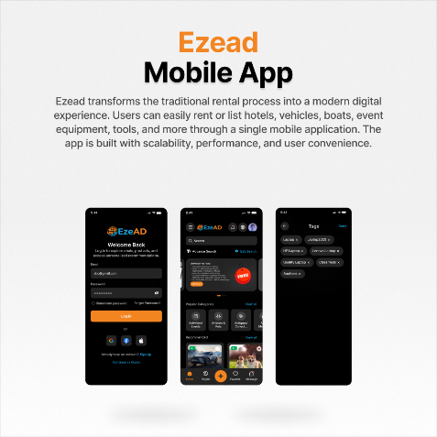
19. Competitive Positioning
EzeAD is not competing within the marketplace category — it is redefining it
Fragmented Competitors vs Unified Platform
Facebook Marketplace → social-first, unstructured transactions
eBay → complex, fee-heavy marketplace
Craigslist → outdated, minimal infrastructure
Kijiji → limited scalability and inconsistent UX
Shopify → requires multiple tools to operate
👉 EzeAD combines all core functions into one integrated ecosystem
Where Competitors Fall Short
Weak trust and verification systems
Fragmented user journeys across multiple platforms
Increasing reliance on ads and pay-to-play visibility
Poor alignment between platform success and user success
EzeAD Structural Advantage
All-in-one commerce ecosystem (listings + services + jobs + auctions + business tools)
AI-powered performance optimization
Trust-first infrastructure with built-in moderation
Performance-based visibility (not pay-to-play)
High-performance system (~399/400 PageSpeed)
Positioning Shift
Competitors = single-purpose platforms
EzeAD = multi-layer infrastructure platform
While competitors operate as isolated tools, EzeAD functions as a unified system — designed to replace, not compete.
Supporting Links
Comparison Positioning: https://www.ezead.com/blog/ezead-vs-facebook-marketplace-buying-selling-comparison

Slide 21
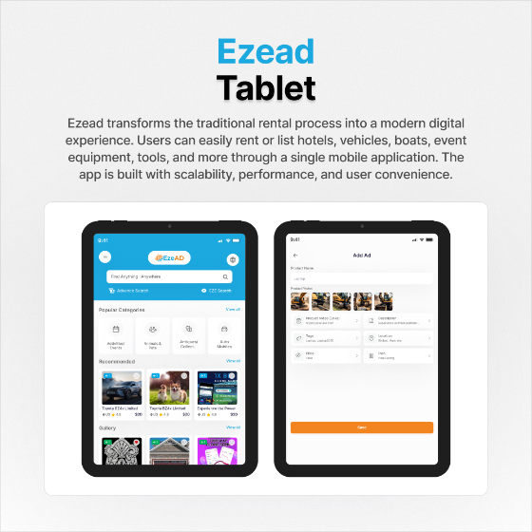
20. Core Monetization Philosophy
Monetization aligned with user success — not platform extraction
Value-Driven Monetization
Revenue generated by enhancing user outcomes, not restricting access
Users pay for visibility, performance, and results — not basic participation
Designed to maximize long-term user retention and lifetime value
Freemium Growth Engine
Free entry → frictionless adoption and rapid user growth
Monetization layered on top of engaged, high-intent users
Enables strong network effects and marketplace density
Performance-Based Revenue Model
Revenue tied to seller success and marketplace activity
High-performing listings and businesses gain greater visibility and conversion
Aligns platform incentives with user success and satisfaction
Multiple Scalable Revenue Streams
Featured listings and visibility upgrades
Business subscriptions and premium accounts
Lead generation and performance-based promotion
Future expansion into transactions, payments, and commerce tools
Long-Term Monetization Strategy
Start with light, user-friendly monetization
Scale into recurring revenue and transaction-based models
Build a sustainable, compounding revenue engine
EzeAD monetizes success — the more value users create, the more the platform grows.

Slide 22
21. Revenue Model – Phase 1
Early-stage monetization focused on validating demand and generating initial revenue
Core Monetization Channels (Phase 1)
Featured Listings & Visibility Boosts
Sellers pay to increase exposure → immediate, high-margin revenue
Business Accounts & Subscriptions
Power sellers and businesses upgrade for enhanced presence and tools
→ recurring revenue foundation
Lead Generation Monetization
Charging for high-intent buyer inquiries and connections
→ performance-based earnings
Strategic Approach
Freemium entry → rapid user acquisition
Monetize only high-value users (power sellers & businesses)
Keep barriers low to maximize marketplace growth and liquidity
Revenue Characteristics
Low complexity, fast to deploy
High-margin digital revenue streams
Directly tied to user activity and marketplace demand
Validation Objective
Prove willingness to pay for visibility and leads
Identify high-performing monetization channels
Establish early revenue traction and repeat usage
📈 Phase 1 Revenue Logic
Listings → Visibility Demand → Paid Upgrades → Revenue
Phase 1 is designed to validate monetization quickly — turning marketplace activity into immediate revenue.

Slide 23
22. Revenue Model – Phase 2
Scaling monetization through marketplace density, recurring revenue, and performance-driven growth
Expanded Monetization Channels
Advanced Business Subscriptions
Tiered plans for businesses and power sellers → predictable recurring revenue
Dealer / Power Seller Plans
Bulk listings, premium tools, and enhanced visibility
→ higher ARPU (average revenue per user)
Sponsored Placement & Priority Exposure
Performance-based promotion within search and listings
→ scalable visibility monetization
Lead Generation Optimization
Premium access to high-quality, high-intent leads
→ higher-value transactions and repeat revenue
Revenue Scaling Drivers
Increasing marketplace density (more listings + users)
Growth in repeat sellers and business participation
Higher demand for visibility, leads, and performance tools
👉 More activity → more competition → more monetization demand
Revenue Characteristics
Strong shift toward recurring and predictable revenue streams
Higher monetization per user through upsells and premium tiers
Revenue growth driven by engagement, retention, and repeat usage
Strategic Objective (Phase 2)
Convert early adopters into paying, recurring users
Strengthen business ecosystem within the platform
Scale monetization alongside user growth and activity
📈 Phase 2 Revenue Logic
Users → Repeat Usage → Subscriptions → Premium Tools → Recurring Revenue Growth
Phase 2 transforms marketplace activity into predictable, recurring revenue at scale.

Slide 24
23. Revenue Model – Phase 3
Full-scale monetization through transactions, payments, and commerce infrastructure expansion
Transaction-Based Revenue
Introduce transaction fees on completed sales and services
Monetize actual value exchange within the platform
Scales directly with marketplace volume and activity
Payments & Fintech Integration
Built-in payment processing system
Monetization through transaction fees and payment margins
Foundation for future wallets, escrow, and financial services
End-to-End Commerce Infrastructure
Enable full transaction flow:
Discovery → Communication → Transaction → Payment → Completion
Keep entire commerce lifecycle within the EzeAD ecosystem
Advanced Business & SaaS Layer
Tools for businesses:
  Analytics & insights
  CRM-style customer management
  Performance dashboards
👉 Monetized through subscription + usage-based pricing
Advertising & Performance Marketing Layer
Sponsored listings and targeted promotion tools
Performance-based advertising aligned with conversion outcomes
High-margin revenue stream at scale
Revenue Characteristics (Phase 3)
Transition to high-volume, transaction-driven revenue
Strong recurring + variable revenue mix
Significant increase in lifetime value (LTV) per user
📈 Phase 3 Revenue Logic
Marketplace Activity → Transactions → Payments → Fees → Scalable Revenue Growth
Phase 3 unlocks the full revenue potential — turning EzeAD into a transaction-driven commerce infrastructure platform.

Slide 25
24. Go-To-Market Strategy
A scalable, low-cost acquisition engine designed to rapidly build marketplace density and monetization
Phase 1: Supply Activation (Liquidity First)
Free listings model to attract sellers and inventory at scale
Focus on onboarding individual sellers, side hustlers, and small businesses
Build strong category depth and marketplace activity
👉 Goal: maximize supply → create marketplace momentum
Phase 2: Demand Generation (Traffic Growth)
SEO-driven growth engine (high-intent organic traffic)
Content strategy via blogs, listings, and search visibility
Mobile-first acquisition targeting local and regional users
👉 Goal: bring consistent buyer traffic to match supply
Phase 3: Network Effects & Retention
Built-in messaging and interaction tools to increase engagement
Encourage repeat usage through ease, speed, and results
Strengthen marketplace through user-to-user activity
👉 Goal: create self-sustaining marketplace growth
Phase 4: Monetization Activation
Convert high-activity users into paid customers (power sellers, businesses)
Introduce visibility upgrades, subscriptions, and lead monetization
Scale revenue alongside marketplace density
👉 Goal: turn engagement into predictable revenue
Growth Channels
Organic SEO (primary driver) — low CAC, high intent
Mobile apps — retention and accessibility
Referral & word-of-mouth — driven by user success
Targeted digital marketing (as scale increases)
📈 Growth Engine Logic
Supply → Demand → Activity → Network Effects → Monetization
EzeAD grows by building marketplace density first — monetization follows naturally as activity scales.

Slide 26
25. 12–24 Month Milestones
Roadmap to scale EzeAD from launch to market expansion
Timeline | Strategic Milestones | Primary Objective
0–3 Months | - Launch acceleration and user onboarding - Activate initial monetization (featured listings, subscriptions) - Optimize platform stability and performance | Establish traction and marketplace activity
3–6 Months | - Expand seller base and category depth - Introduce business accounts and seller tools - Increase listing volume and liquidity | Build strong marketplace density
6–12 Months | - Scale recurring revenue (subscriptions, power sellers) - Optimize lead generation and monetization - Expand user acquisition across key regions | Drive consistent revenue growth
12–24 Months | - Expand into new markets and regions - Introduce transaction and payment layers - Strengthen brand and platform positioning | Achieve scale and market leadership
📈 Growth Logic
Launch → Liquidity → Revenue → Scale → Expansion
A clear execution roadmap designed to convert platform readiness into measurable growth, revenue, and market dominance.

Slide 27
26. Funding Ask
Seeking Funding to accelerate growth, monetization, and market expansion
📊 Capital Allocation & Strategy
Category | Allocation | Focus Area
User Acquisition & Growth Marketing | 30% | Scale user base, drive traffic, and increase marketplace activity
Marketplace Expansion & Supply Activation | 25% | Grow listings, onboard sellers, and increase category depth
Monetization Systems & Revenue Optimization | 20% | Activate subscriptions, featured listings, and lead monetization
Technology & Infrastructure | 15% | Enhance performance, scalability, and platform stability
Operations & Team Expansion | 10% | Build execution team across product, growth, and support
📈 Runway & Deployment
Metric | Details
Runway | 18–24 months
Stage | Built, operational, commercialization phase
Capital Use | Scaling growth, not product development
Outcome | User growth, revenue expansion, market penetration
This capital accelerates a fully built platform into scalable growth, revenue, and market leadership.

Slide 28
27. Use of Funds
Capital allocated to accelerate growth, monetization, and scalable infrastructure
📊 Fund Allocation Breakdown
Category | Allocation | Strategic Focus
User Acquisition & Growth Marketing | 30% | Drive traffic, onboard users, and build marketplace demand at scale
Marketplace Expansion & Supply Activation | 25% | Increase listings, seller participation, and category depth
Monetization Systems & Revenue Optimization | 20% | Activate subscriptions, featured listings, and lead generation systems
Technology & Infrastructure | 15% | Enhance performance, scalability, and system reliability
Operations & Team Expansion | 10% | Build execution capacity across product, growth, and support
📈 Execution Focus
Area | Outcome
Growth | Rapid user acquisition and marketplace activity
Monetization | Early revenue generation and scaling recurring income
Platform | Stable, high-performance infrastructure for scale
Operations | Strong execution team to support expansion
Every dollar is deployed to accelerate growth, activate revenue, and scale a platform already built for success.

Slide 29
28. High-Level Commercial Projection Logic
A scalable revenue engine where growth in marketplace activity directly drives monetization
📈 Core Commercial Logic
User Growth → Listings → Marketplace Activity → Monetization Demand → Revenue Growth
Stage 1: Marketplace Activation
Increase users and listings through freemium model
Build marketplace liquidity and engagement
Drive initial demand for visibility and lead generation
👉 Output: early monetization begins
Stage 2: Monetization Expansion
Convert active users into paying customers (sellers & businesses)
Scale subscriptions, featured listings, and lead monetization
Increase average revenue per user (ARPU)
👉 Output: recurring and predictable revenue growth
Stage 3: Marketplace Scaling
Higher marketplace density → more competition for visibility
Increased demand for premium tools and performance upgrades
Growth in repeat users and business participation
👉 Output: compounding revenue growth
Stage 4: Transaction Layer (Long-Term Upside)
Introduce transaction fees and payment systems
Monetize full commerce lifecycle within the platform
Expand into high-volume, transaction-driven revenue
👉 Output: exponential revenue potential
Driver | Impact on Revenue
User Growth | Expands total market activity
Listing Volume | Increases monetization opportunities
Engagement | Drives demand for visibility and leads
Business Adoption | Strengthens recurring revenue
Transactions | Unlocks high-scale revenue layer
EzeAD’s revenue scales naturally with marketplace activity — the more the platform is used, the more it earns.

Slide 30
29. Leadership & Team Buildout
Building a high-performance team to execute, scale, and commercialize EzeAD
Leadership & Team Buildout
Building a high-performance team to execute, scale, and commercialize EzeAD
Founder-Led Execution
Strong product vision backed by 4+ years of development and execution
Deep understanding of marketplace dynamics, user behavior, and platform design
Proven ability to build and deliver a complete, operational system
Core Team Expansion
Hiring across engineering, product, growth, and operations
Focus on building a team capable of rapid execution and continuous improvement
Strengthening capabilities in AI, infrastructure, and marketplace optimization
Growth & Commercial Team
Dedicated team for user acquisition, partnerships, and revenue growth
Focus on scaling marketplace activity and monetization performance
Building expertise in digital marketing, SEO, and conversion optimization
Operational Excellence
Establishing strong processes for support, moderation, and platform reliability
Ensuring smooth scaling of user activity and marketplace operations
Maintaining high standards of performance, trust, and user experience
Strategic Hiring Focus
Prioritize execution-driven talent over early-stage experimentation
Build a lean, efficient team aligned with growth and revenue goals
Scale team size in line with marketplace growth and demand
The next phase is not about building the product — it’s about building the team to scale it.

Slide 31
30. Why Now
The market is proven. The problem is clear. The solution is ready.
Massive Demand, Broken Platforms
Global marketplaces (Facebook, eBay, Craigslist, Shopify) have validated billions in demand
Yet users face low trust, poor UX, high fees, and fragmented systems
👉 Demand exists — but the infrastructure is failing
Shift in User Expectations
Users now expect fast, simple, all-in-one platforms
Growing frustration with ads, complexity, and pay-to-play models
Increasing demand for performance, trust, and efficiency
Perfect Timing Window
Legacy platforms are aging, complex, and misaligned
No dominant player has solved integration + trust + performance together
Market is ready for a next-generation marketplace infrastructure
EzeAD’s Advantage
Fully built and operational — not early-stage
Entering at the commercialization and scaling phase
Positioned to capture users across multiple categories simultaneously
Execution Over Idea
Competitors rely on legacy systems and incremental improvements
EzeAD delivers a structural shift in how marketplaces operate
👉 This is the moment where execution wins
This is the inflection point — where a built platform meets a broken market ready to shift.

Slide 32
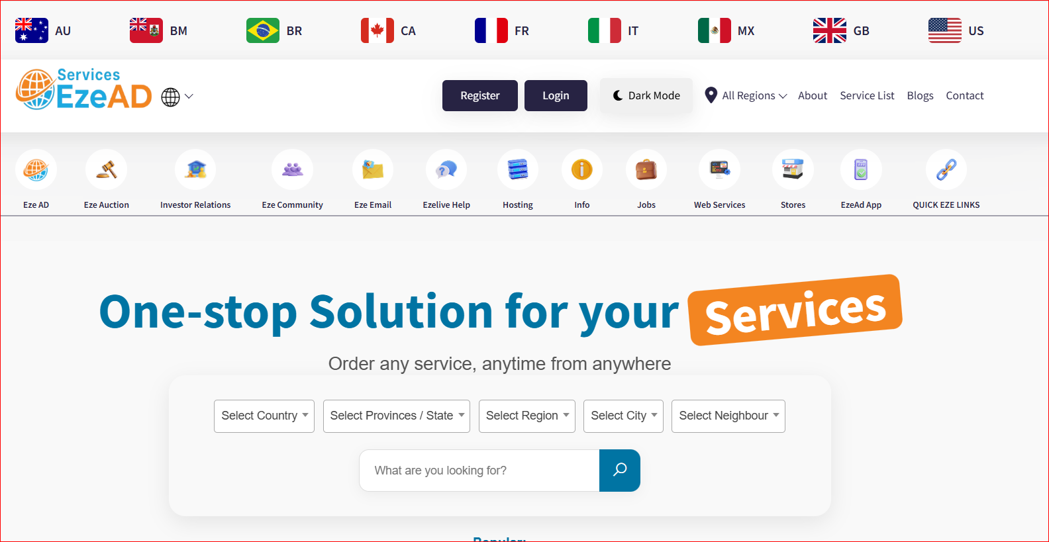
31. Supporting Platform & Brand Links
Supporting Links
Investor Page: https://www.ezead.com/pages/ezead-Investors Mission Page: https://www.ezead.com/pages/our-mission-at-ezead Main Platform: https://www.ezead.com
Marketplace / Shop: https://www.ezead.com/shop Blog / SEO Engine: https://www.ezead.com/blog
Platform Explainer: https://www.ezead.com/blog/what-is-ezead-classified-ads-website How Selling Works: https://www.ezead.com/blog/how-to-sell-used-items-fast-ezead
Competitive Positioning: https://www.ezead.com/blog/ezead-vs-facebook-marketplace-buying-selling-comparison

Slide 33
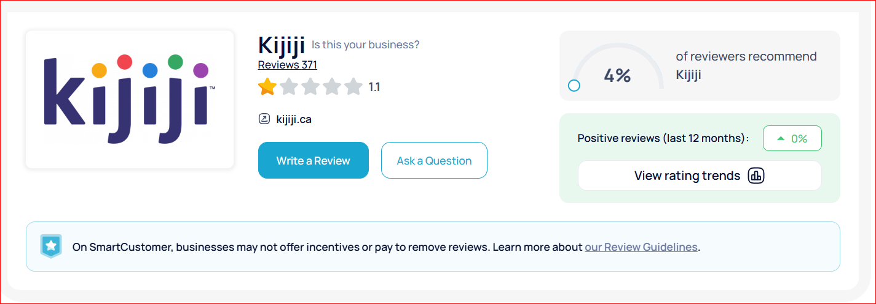
32. Global Marketplace & Commerce Platform User Sentiment Analysis
(Kijiji + eBay + Facebook Marketplace + Craigslist + Shopify)
Executive Summary
Across independent consumer review platforms (including Smart Customer-style aggregators), leading global platforms
Kijiji ► https://www.smartcustomer.com/reviews/kijiji.ca
eBay ► https://www.smartcustomer.com/reviews/ebay.com
Facebook Marketplace ► https://www.smartcustomer.com/reviews/facebook.com
Craigslist ► https://www.smartcustomer.com/reviews/craigslist.org
Shopify ► https://www.smartcustomer.com/reviews/shopify.com
► Show consistent, repeating user dissatisfaction patterns at scale.
֎ This confirms:
Massive global demand for marketplaces and e-commerce platforms
But systemic failure in trust, usability, support, and monetization alignment
📉 Aggregate Market Sentiment
Common Pattern Across All Platforms:
High complaint volume
Low trust ratings across review aggregators
Repeated negative user experiences
֎ Critical Insight:
Users are not leaving due to lack of demand
Users are leaving due to poor platform experience and lack of trust

Slide 34
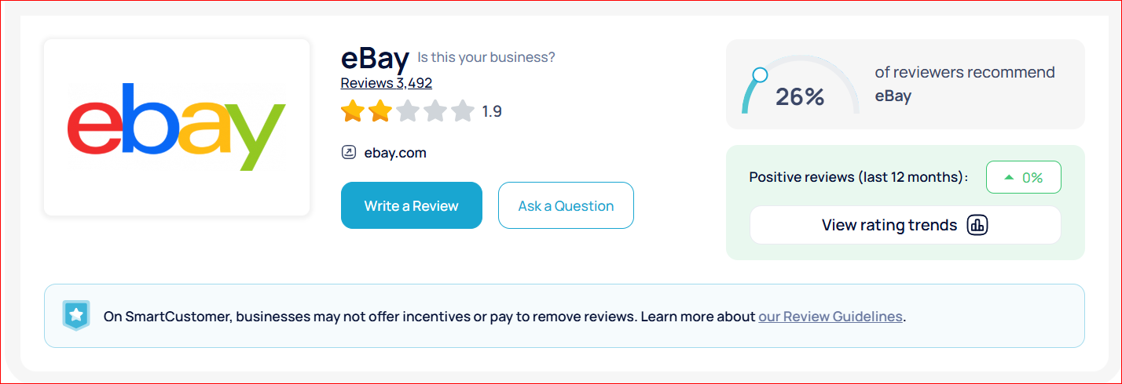
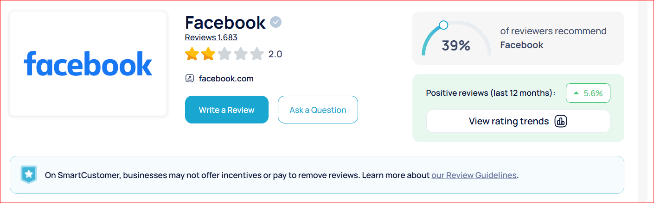
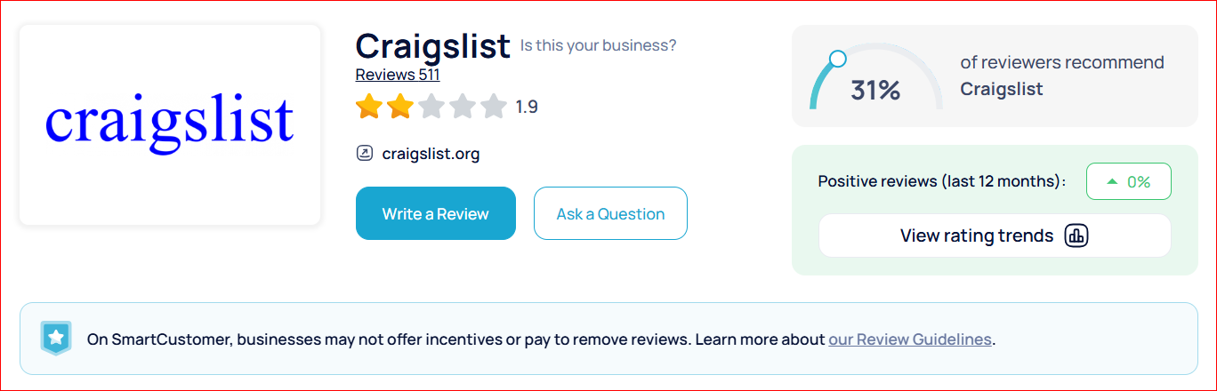
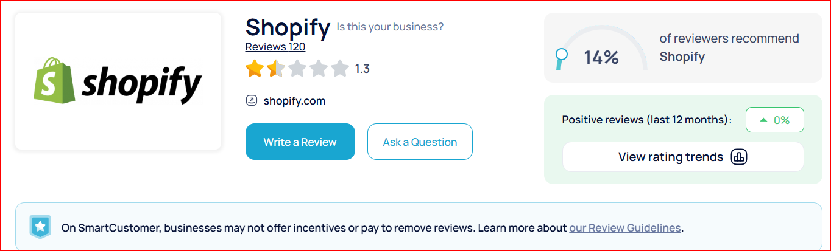
33. Global Marketplace & Commerce Platform User Sentiment Analysis
(Kijiji + eBay + Facebook Marketplace + Craigslist + Shopify)

Slide 35
34. Global Marketplace & Commerce Platform User Sentiment Analysis
(Kijiji + eBay + Facebook Marketplace + Craigslist + Shopify)
🔐 Trust & Safety Breakdown
Frequent scam reports (buyers & sellers)
Fake listings, fraudulent stores, impersonation
Weak or non-existent identity verification
👉 Users forced to self-manage risk
Sources:
https://www.smartcustomer.com/reviews/kijiji.ca
https://www.smartcustomer.com/reviews/facebook.com
https://www.smartcustomer.com/reviews/craigslist.org
https://www.smartcustomer.com/reviews/shopify.com
2. ⚖️ Dispute Resolution & Support Failures
      Limited or ineffective support
      Automated or scripted responses
      Lack of escalation paths
      Unresolved financial disputes
👉 Users lack reliable protection mechanisms
Sources:
https://www.smartcustomer.com/reviews/ebay.com
https://www.smartcustomer.com/reviews/facebook.com
https://www.smartcustomer.com/reviews/shopify.com
📌 Supporting insight:
Shopify reviews average ~1.3–1.5 stars on SmartCustomer, with frequent complaints about customer service and business impact

Slide 36
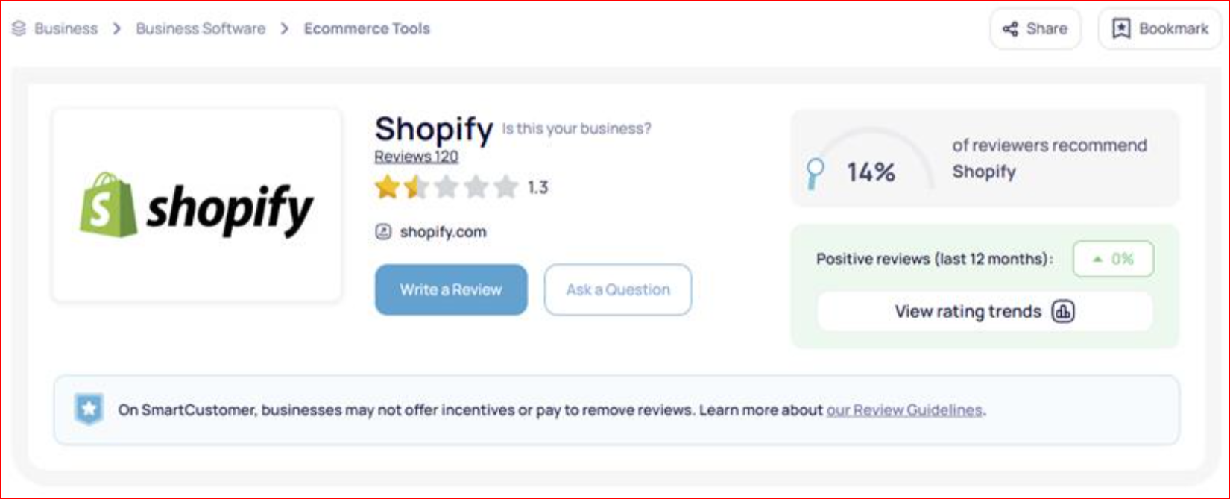
35. Global Marketplace & Commerce Platform User Sentiment Analysis
(Kijiji + eBay + Facebook Marketplace + Craigslist + Shopify)
3. 💰 Monetization Misalignment
Pay-to-promote visibility models
Increasing listing / platform costs
Reduced organic reach
👉 Perception:
Platforms prioritize revenue over user success
Sources:
  https://www.smartcustomer.com/reviews/ebay.com
https://www.smartcustomer.com/reviews/kijiji.ca
https://www.smartcustomer.com/reviews/shopify.com
4. 🧾 Feedback & System Integrity Issues
Manipulated or incomplete feedback loops
Low participation rates
Difficulty correcting false or unfair reviews
👉 Trust signals are degrading
Sources:
https://www.smartcustomer.com/reviews/ebay.com

Slide 37
36. Global Marketplace & Commerce Platform User Sentiment Analysis
(Kijiji + eBay + Facebook Marketplace + Craigslist + Shopify)
5. 🧩 Platform Complexity & Friction eBay
Increasing feature complexity
Multi-step transaction processes
Facebook Marketplace
Informal, inconsistent structure
No standardized transaction system
Kijiji
Aging interface
Poor search reliability
Craigslist
Extremely outdated UX
Minimal moderation
Shopify
Increasing reliance on paid apps
Fragmented ecosystem for full functionality
Technical complexity for scaling businesses
👉 Combined Result:
Increased friction = reduced conversion and user satisfaction

Slide 38
37. Global Marketplace & Commerce Platform User Sentiment Analysis
(Kijiji + eBay + Facebook Marketplace + Craigslist + Shopify)
6. 📉 Declining User Experience Over Time
Common sentiment across all platforms:
“It used to be better”
Increased ads / monetization pressure
Reduced organic visibility
More spam, fraud, and low-quality listings
Sources:
https://www.smartcustomer.com/reviews/kijiji.ca
https://www.smartcustomer.com/reviews/craigslist.org
https://www.smartcustomer.com/reviews/shopify.com
⚠️ Platform-Specific Structural Weaknesses
Facebook Marketplace
Source: https://www.smartcustomer.com/reviews/facebook.com
Weak enforcement
High scam exposure
No structured transaction system
👉 Social-first, not transaction-first
Craigslist
Source: https://www.smartcustomer.com/reviews/craigslist.org
Minimal oversight
No safeguards
Outdated infrastructure
👉 Legacy platform with minimal evolution
Shopify
Source: https://www.smartcustomer.com/reviews/shopify.com
Low user satisfaction (~1.3–1.5 stars)
Customer support frequently criticized
Reports of billing disputes and lack of resolution
Platform complexity increases operational burden
👉 Commerce infrastructure without aligned support or protection

Slide 39
38. Global Marketplace & Commerce Platform User Sentiment Analysis
(Kijiji + eBay + Facebook Marketplace + Craigslist + Shopify)
📊 Structural Breakdown of Legacy Platforms
Core Function | Current Reality
Trust | Weak / user-dependent
Verification | Limited or absent
Support | Inconsistent / ineffective
Visibility | Pay-to-play or unstructured
UX | Fragmented / outdated
Monetization | Misaligned with user success
Feedback Systems | Degrading reliability
💡 Investor Insight
“The global marketplace and e-commerce sector is not broken due to lack of demand—it is broken due to outdated infrastructure, declining trust, and misaligned incentives across all major platforms.”
👉 This is a system-wide structural failure

Slide 40
39. Strategic Positioning for EzeAD
Position as a next-generation marketplace + commerce infrastructure:
✅ Trust Infrastructure First
Verified ecosystem
Transparent interactions
✅ Performance-Based Visibility
SEO-driven exposure
Not pay-to-play
✅ Unified Platform Experience
Eliminates fragmentation
Reduces reliance on third-party tools
✅ User-Aligned Monetization
Rewards outcomes
Not listing volume or ad spend
🔥 Closing Statement (Investor-Grade)
“Legacy platforms such as Kijiji, eBay, Facebook Marketplace, Craigslist, and Shopify validated the global marketplace and e-commerce model—but user feedback clearly highlights systemic breakdowns in trust, usability, and effectiveness.
EzeAD is positioned to capitalize on this gap by delivering a next-generation platform built for performance, transparency, and global scalability.”

Slide 41

40. Why Ezead Is Now Extremely Strong
Covers full competitive landscape:
  Classifieds
  Marketplaces
  Social commerce
  E-commerce infrastructure
Backed by third-party review data
Shows system-wide failure—not isolated issues
Positions EzeAD as:
👉 category-defining, not just competitive
If you want to take this to the next level investors expect, I recommend:
👉 “add market gap visual page” (this becomes VERY compelling)
👉 or “merge into full $5M funding package”

Slide 42
41. What EzeAD Is — and What It Will Become
EzeAD is not simply another classifieds platform or marketplace. It is being built as a global, search-first digital infrastructure layer for local commerce — designed to organize, index, and monetize everything that can be bought, sold, or promoted within a geographic market
What EzeAD Is Today
A fully developed, operational platform
Built over multiple years with founder-led capital (no external debt)
Architected with near-perfect technical performance (~399/400 PageSpeed)
Structured for global deployment down to the neighborhood level
Designed around SEO dominance and AI discoverability
Unlike most early-stage ventures, this is not a concept or prototype — it is a finished system entering its scale phase
What EzeAD Will Become
1. The Infrastructure Layer for Local Commerce
Not competing within marketplaces — but sitting underneath them.
Every listing is indexed
Every region is structured
Every search intent is captured
2. A Search-Dominant Acquisition Engine
Capture organic search at scale
Enable AI bots and crawlers to index efficiently
Create compounding traffic growth over time
3. A Scalable Global Rollout Model
Countries, regions, cities, neighborhoods
Market-by-market activation without rebuilding infrastructure
4. A Multi-Vertical Monetization Platform
Classifieds
Local services
Business advertising
Featured placements
Lead generation

Slide 43
42. What EzeAD Is — and What It Will Become
Why This Matters (Investor Perspective)
Most competitors (eBay, Facebook Marketplace, Shopify) are feature-heavy, infrastructure-inefficient, and dependent on paid traffic.
EzeAD is infrastructure-first, search-native, performance-optimized, and designed for compounding growth.
The Strategic Difference
Most platforms ask: How do we add more features?
EzeAD asks: How do we structure the entire market so it can be indexed, discovered, and scaled efficiently?
Bottom Line
EzeAD represents a transition from a platform business to a scalable digital infrastructure model for global local commerce.
Potential outcome:
• High-margin, search-driven ecosystem
• Low acquisition cost
• Massive geographic scalability
One-Line Investor Summary
EzeAD is building the underlying infrastructure for how local commerce is indexed, discovered, and monetized globally.

Slide 44
43. Closing
EzeAD is built. EzeAD is operational. EzeAD is ready.
Use Full Link : https://www.ezead.com/pages/why-invest-inezead
What We’ve Achieved
A fully developed, AI-powered marketplace ecosystem
Multi-category platform with real infrastructure, not just concept
High-performance system designed for global scale
What Comes Next
Scale user acquisition and marketplace activity
Activate and expand monetization at scale
Build toward transaction-driven commerce infrastructure
The Opportunity
Enter at the point where product risk is eliminated
Capital fuels growth, revenue, and market capture
Positioned to become a category-defining platform
We are now opening the next phase of growth — and inviting strategic investors to be part of it.

